Slide 1
Activities Done In SCRUM Methodology
Planning Meeting
A planning meeting is the starting point of Sprint. It is the meeting where the entire scrum team gathers, the SCRUM Master selects a user story based on the priority from the product backlog and the team brainstorms on it
The scrum team decides the complexity of the story and sizes it as per the Fibonacci series. The team identifies the tasks along with the efforts (in hours) which would be done to complete the implementation of the user story
The planning meeting is preceded by a “Pre-Planning meeting”. It’s just like a homework which the scrum team does before they sit for the formal planning meet. The team tries to write down the dependencies or other factors which they would like to discuss in the planning meeting.

Slide 2
Execution of Sprint Tasks
The name suggests, these are the actual work done by the scrum team to accomplish their task and take the user story into the “Done” state.

Slide 3
Daily Standup
During the sprint cycle, every day the scrum team meets for, not more than 15 minutes (could be a stand-up call, recommended to have during the beginning of the day) and state 3 points
What did the team member do yesterday?
What did the team member plan to do today?
Any impediments (roadblocks)?
It is the Scrum master who facilitates this meeting. In case, any team member is facing any kind of difficulties, the scrum master follows up to get it resolved. In Stand ups, the board is also reviewed and in itself shows the progress of the team.

Slide 4
Review Meeting
At the end of every sprint cycle, the SCRUM team meets again and demonstrates the implemented user stories to the product owner.
The product owner may cross verify the stories as per its acceptance criteria. It’s again the responsibility of the Scrum master to preside over this meeting.
The SCRUM tool, the Sprint is closed and the tasks are marked done.

Slide 5
Retrospective Meeting
The retrospective meeting happens after the review meeting
The SCRUM team meets, discusses & document the following points:
What went well during the Sprint (Best practices)?
What did not go well in the Sprint?
Lessons learned
Action Items
The Scrum team should continue to follow the best practice, ignore the “not best practices” and implement the lessons learned during the consequent sprints
The retrospective meeting helps to implement the continuous improvement of the SCRUM process

Slide 6
The Process
Example:
Step #1: Let’s have a SCRUM team of 9 people comprising of 1 product owner, 1 Scrum master, 2 testers, 4 developers and 1 DBA.
Step #2: The Sprint is decided to follow a 4 weeks cycle. So we have 1-month Sprint starting 5th June to 4th of July.
Step #3: The Product owner has the prioritized list of user stories in the product backlog.
Step #4: The team decides to meet on 4th June for the “Pre Planning” meeting.
The product owner takes 1 story from the product backlog, describes it and leaves it to the team to brainstorm on it.
The entire team discusses and communicates directly to the product owner to have clearly understood the user story.

Slide 7
The Process continued
In a similar way, various other user stories are taken. If possible, the team can go ahead and size the stories as well.
After all the discussion, Individual team members go back to their workstations and
Identify their individual tasks for each story.
Calculate the exact number of hours on which they will be working. Let's check how the member concludes these hours.
Total number of working hours = 9
Minus 1 hour for a break, minus 1 hour for meetings, minus 1 hour for emails, discussions, troubleshooting etc.

Slide 8
The Process continued
So the actual working hours = 6.
A total number of working days during the Sprint = 21 days.
Total number of hours available = 21*6 = 126.
The member is on leave for 2 days = 12 hours (This varies for each member, some may take leave and some may not.)
Number of actual hours = 126 – 12 = 114 hours.
This means that the member will actually be available for 114 hours for this sprint. So he will break down his individual sprint task in such a way that a total of 114 hours is reached.

Slide 9
The Process continued
Step #5: On the 5th of June the entire Scrum team meets for the “Planning Meeting”.
The final verdict of the user story from the product backlog is done and the story is moved to the Sprint Backlog.
For each story, each team member declares their identified tasks, if required they can have a discussion on those tasks, can size or resize it (remember the Fibonacci series!!).
The Scrum master or the team enter their individual tasks along with their hours for each story in a tool.
After all the stories are completed, Scrum master notes the initial Velocity and formally starts the Sprint.

Slide 10
The Process continued
Step #6: Once the Sprint has started, based on the tasks assigned, each team member starts working on those tasks.
Step #7: The team meets daily for 15 minutes and discusses 3 things:
What did they do yesterday?
What they plan to do today?
Any impediments (roadblocks)?

Slide 11
The Process continued
Step #8: The scrum master tracks the progress on a daily basis with the help of “Burn down chart”.
Step #9: In case of any impediments, the Scrum master follows up to resolve those.
Step #10: On 4th July, the team meets again for the review meeting. A member demonstrates the implemented user story to the product owner.
Step #11: On 5th July, the Team meets again for the Retrospective, where they discuss
What went well?
What did not go well?
Action Items.

Slide 12
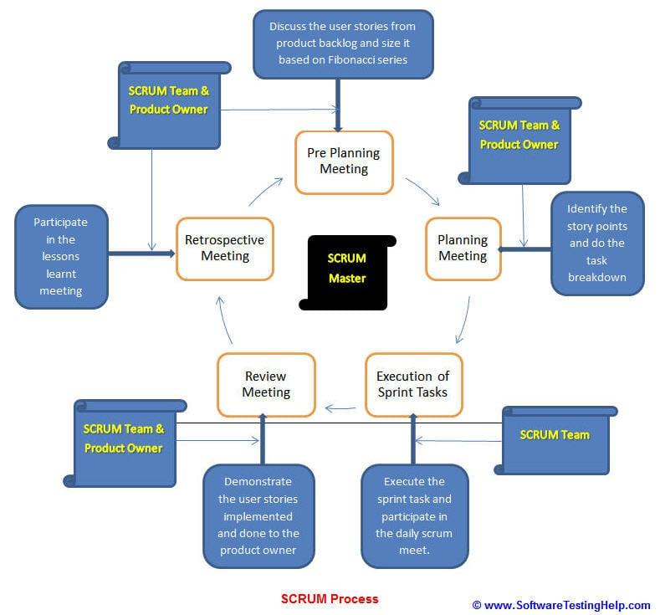
The Process continued
Step #12: On 6th July, the Team again meets for pre-planning meeting for the next sprint and the cycle continues

Slide 13
SCRUM Activity Tools
There are several tools that can be used extensively for tracking the scrum activities.
Some of them include:
Jira
XPlanner
VersionOne
Sprintometer
ScrumNinja

Slide 14
Jira : Japan Industrial Robot Association or Japan Robot Association
JIRA is a tool developed by Australian Company Atlassian. It is used for bug tracking, issue tracking , and project management
The name "JIRA" is actually inherited from the Japanese word "Gojira" which means "Godzilla“
The basic use of this tool is to track issue and bugs related to your software and Mobile apps
It is also used for project management. The JIRA dashboard consists of many useful functions and features which make handling of issues easy

Slide 15
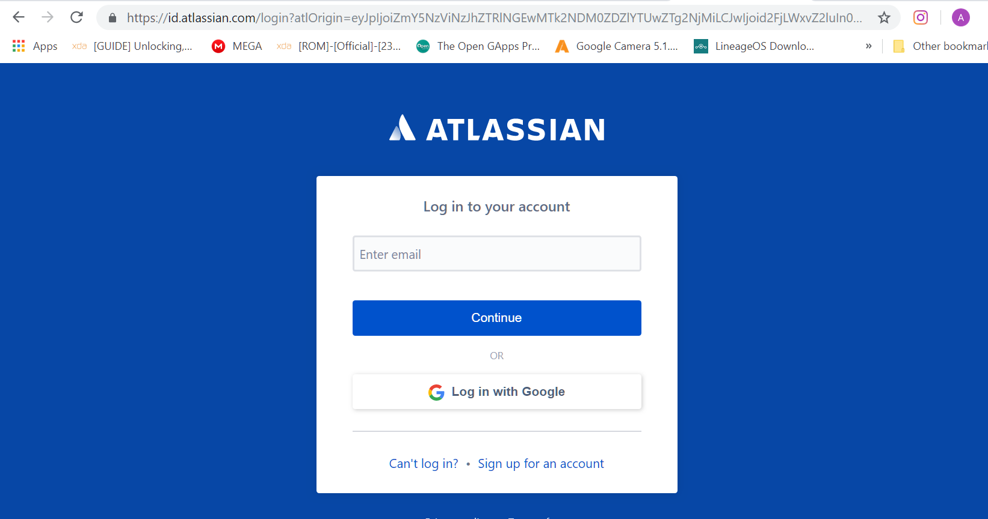
Jira
https://www.atlassian.com/

Slide 16
Xplanner
XPlanner is one of the first web based agile project management tools and it had more features than other products
XPlanner is solid and used by many companies. However, XPlanner development was stopped many years ago (latest release May-2008)
Most feature-complete tool among other free open source products
Integrated time tracking
Several nice reports like burn down chart
Export
SOAP API
Email Notifications
Hard setup for anyone who do not familiar with Java world
No releases, iterations only

Slide 17
Versionone
VersionOne is a formidable Agile management solution that is both comprehensive and versatile and developed for teams and projects of various scope and size.
It is a compact platform that delivers outstanding performance in terms of managing and tracking multiple teams, tasks, and projects. Simple to use and highly scalable, VersionOne continues to excel in the Agile market, highly used and recommended by businesses of any shape or size
VersionOne is structured to support other agile software methodologies, including Kanban, Hybrid, Scrum, Lean, SAFe®, and XP enabling companies to scale agile quicker, simpler, and smarter

Slide 18
Features
Agile Portfolio Management
Reporting & Analytics
Product Planning
Product Roadmapping
Release Planning
Idea Management
Sprint Planning
Test Management
Tracking
Collaboration
Review
Open Integration Platform

Slide 19
Sprintometer
A simple free tool with modern GUI for Scrum and Extreme Programming projects tracking
Features:
Scrum and XP (Extreme Programming) projects tracking
Burn down chart for the whole project
Concurrent team work with automatic data merge
Unique 3D Burn Down chart and Burn Down with statistical prediction
Unique support for standalone and server mode with one client
Support for variable team size
Quick printing option

